Slide 1
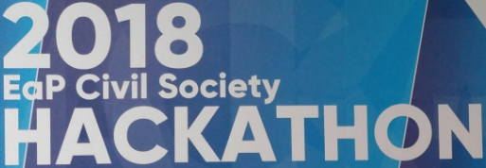
E-democracy: UA case
June’3, Minsk

Slide 2
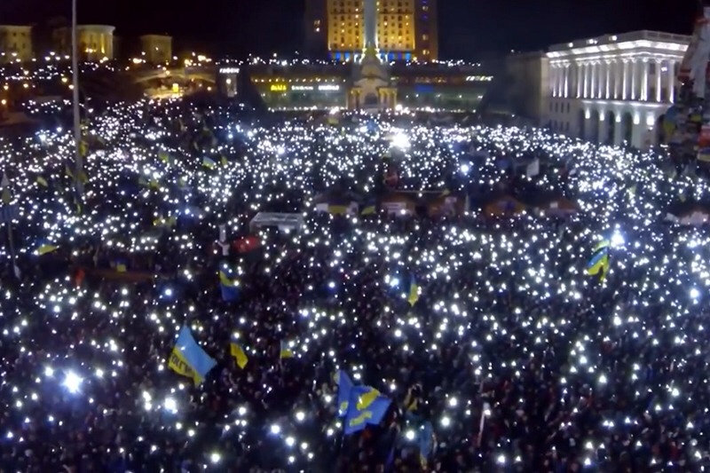
What are your dreams about?
Would you like to treat your KARMA? :)

Slide 3
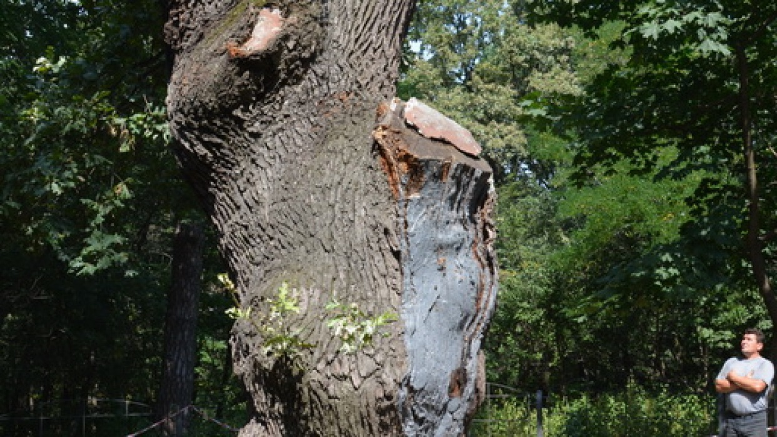
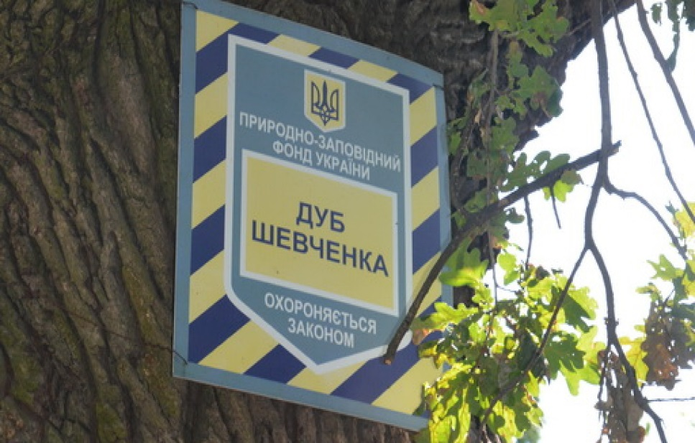
Kyiv Participatory Budget project sample:
Treatment of 400-years Old Tree (to live >1,000 years)
Goal: Preservation of One
Outcome: City program to register and save ALL (400+)
Budget:
about 2,500 Euro

Slide 4
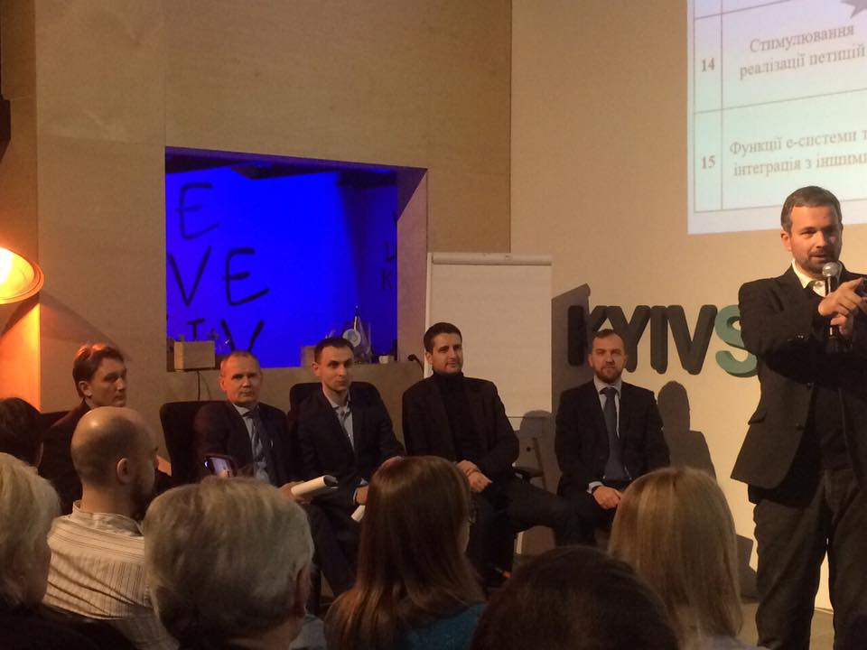
Due to …
NO VOICE AGAINST from City Council
Kyiv Local Gov. supports E-Democracy
5

Slide 5
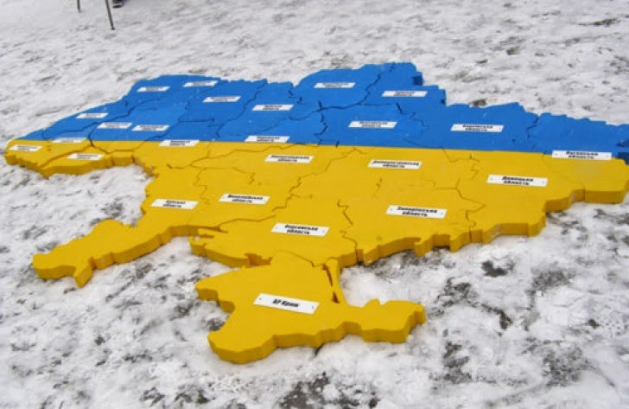
E-Democracy and Democracy
Ukraine is ranked among 193 member states of the UN
32 place
vs.
86 place
+ 45 steps up (!!!)
after 2014
+6 steps up
after 2014

Slide 6
e-Democracy in UA
 | 2017-18 |  | 2020+
International rating (UN) | 32 place (before - 74) | => | top-20
Scope of e-participation in UA, citizens | 1+ MLN | => | 5+ MLN
due to:
Kyiv (petitions, PB, 1551, other) | 500+ thousand | => | 1+ mln
President, Gov., Parliament (petitions, apeals, etc.) | 400+ thousand | => | 2-5 mln
Platform for e-petions (е-dem.in.ua +Open city, Smart city) | 300+ thousand | => | ?? mln
Participatory budgets + e-voting (?), e-consultations (?) | 300+ thousand (without Kyiv) | => | 2-5 mln
OTHER | 50+ thousand | => | ?? mln
+ e-dem platform of municipalities/regions (based on unified citizen’s e-cabinet) | 0+ thousand | => | 5+ mln
Україна займає серед 193 країн-членів ООН
32 місце
vs.
86 місце
+ 45 сходинок вгору
після 2014
+ 6 сходинок

Slide 7
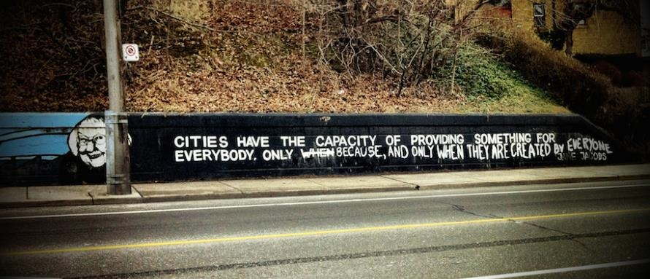
What is the future model of the community / city?
GOVERNMENT
МІСТО - ???
CITY - ???
CITY
V-1.1:BUREAUCRATIC
V-1.2: MAFIA
???

Slide 8
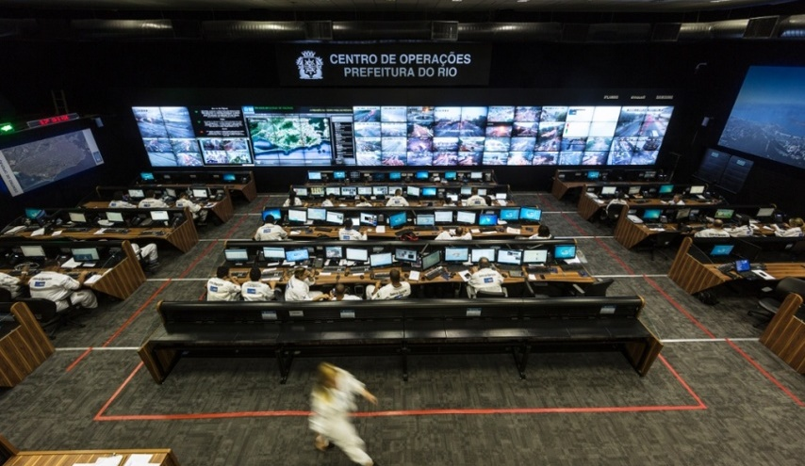
It is enough for a SmartCity?
1. IT, IT…
2. BIG DATA
3. Open DATA
RIO OP center

Slide 9
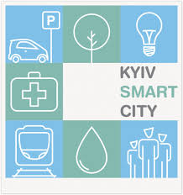
Tools 4 e-Democracy: Kyiv case
Participatory budget
(1+ year)
Е-petitions
(3 years)
Е-appeals
(5+ years)
200+ K
*
500+ K
*
100+тис.
*
Teams, Authors
of РB, petitions
Active NGOs
of 12K registered
1,000
500+
Under DEVELOPMENT in KYIV:
ver. 2-3.0 of existing e-services
+ KyivID (e-Cabinet of citizen)
+ e-Consultations/Active citizen
*
Top-effective methods of engagement (research-2017 CEDOS, Council of Europe)

Slide 10
Which tools are more effective
to develop democracy?
On-line
Off-line

Slide 11
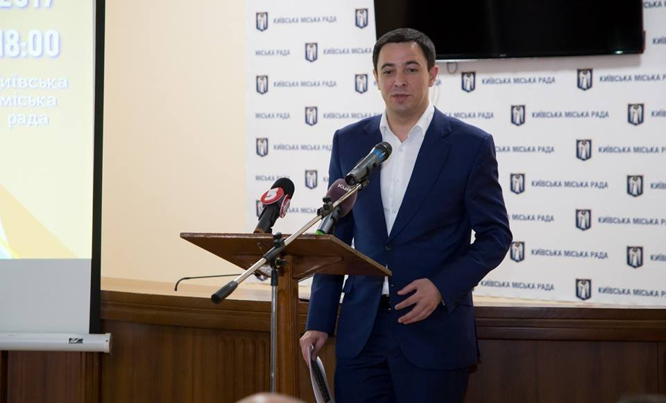
- The highest number of nessesery votes per capita - 10,000 / 3 MLN (10x more than in USA)
- 100% of answers are signed by the Mayor (80% of petitions were supported)
- City Council reporting: monthly (at the site), weekly (digests to all users), fresh informing in FB
- Road-maps on implementation - by the Gov. in agreement with the Authors
- "Privileges" to Petitioners - access to top-authorities, to PB, to attract supporters of their petitions, etc.
- Continuous improvement of the site and legal (already 3.0)
Kyiv: for the 1st time in UA on Petitions

Slide 12
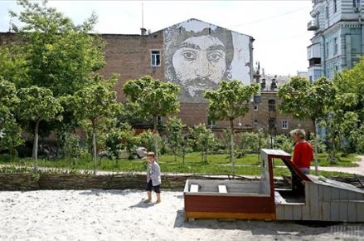
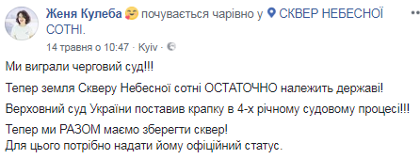
Kyiv: Petitions are working (petition.kyivcity.gov.ua)
10K signitures/ 2 days

Slide 13
Development of e-democracy: Participatory Budget BOOM
Lutsk
Poltava
Chernigov
Cherkasy
2015 year
=
democratic revolution :)
UA SpaceX :)
Participatory Budget
Regional centers
General data
~ 3000 projects
100+ local governments
2017-18
voted
~ 0,5 млн осіб
~1 MLN citizens
~ 850 million UAH

Slide 14
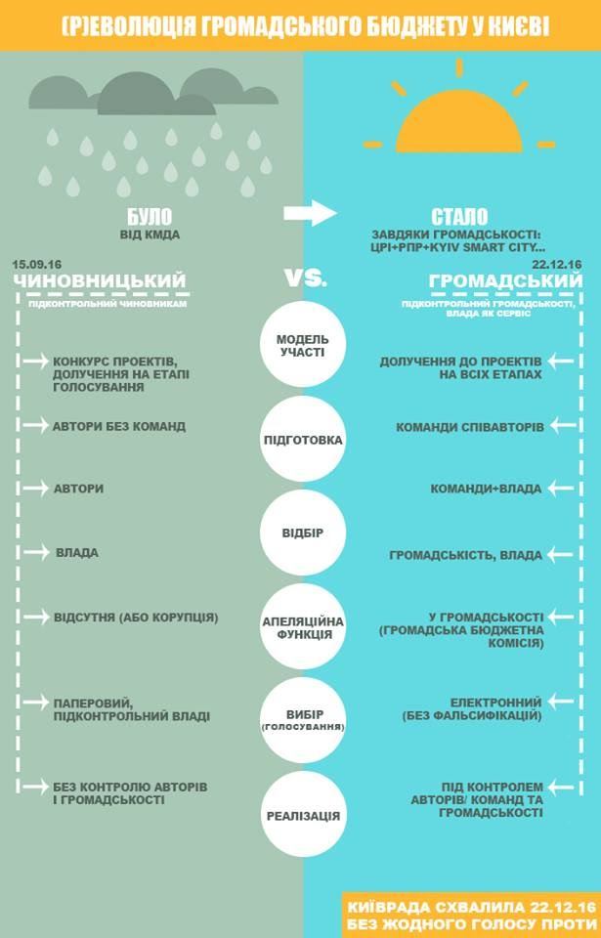
What
model of РB
is needed?

Slide 15
KYIV: for the 1st time on Participatory Budget
100% E-voting with 100% ID (since December’22, 2016.
May’31, 2018 UA National Bank proposed to recognize BankID as the passport :) )
Project Authorth/Teams have legal rights to control implementation (even to stop the project)
PB to motivate innovators by:
Projects are public ownership, but innovators can get money for their IP rights
Projects to be more efficient than similar projects from the Government
Civic Teams building (instead of individuals) and e-system to help with this
Code of Ethics, list of righteousness (and none-righteousness) and e-system to help with this
Public Deputies not to compete directly with active citizans by:
need to act publicly and to declare their potential support to All
new formula 4 projects rating - new civic Teams can overcompete the Deputies
Civic Budget Commission (“civic court”) e-elected by citizens

Slide 16
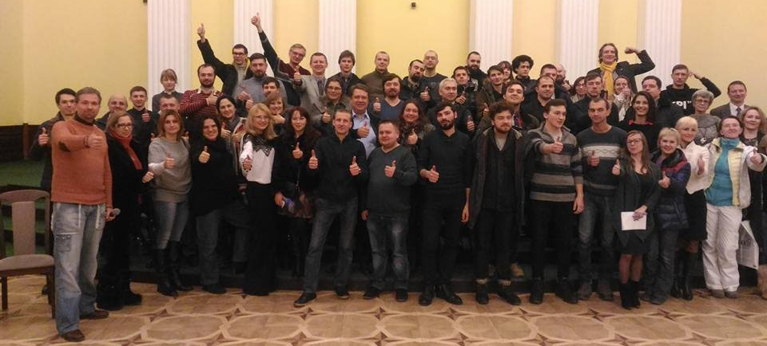
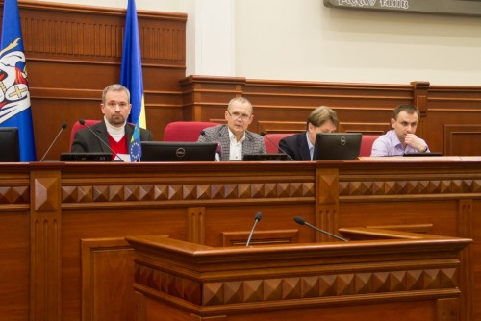
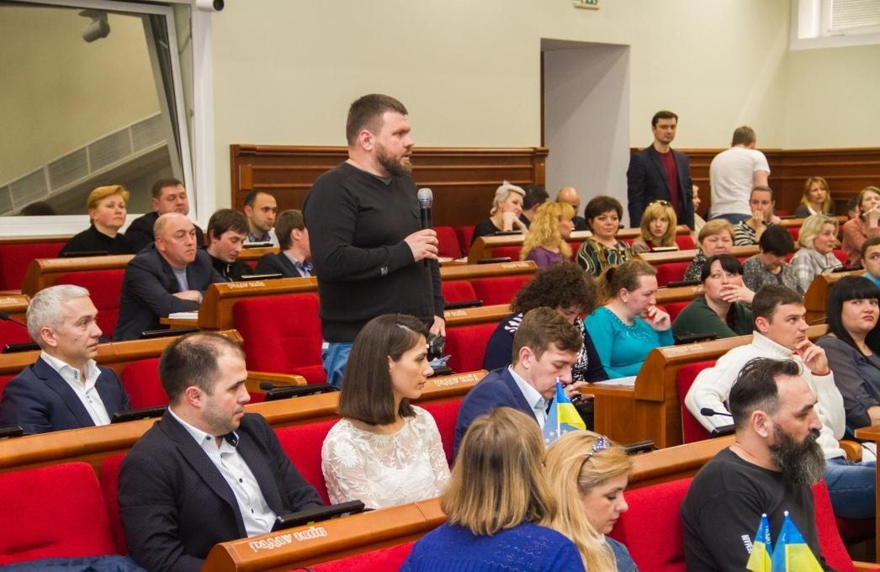
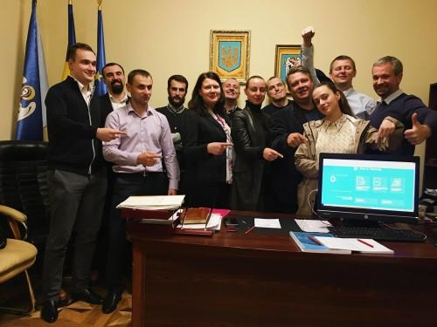
KYIV: for the 1st time in Ukraine on Participatory Budget
Realization
90+%

Slide 18
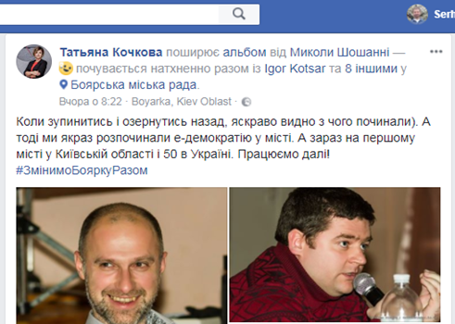
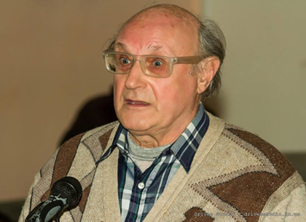
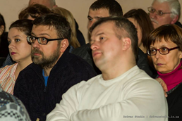
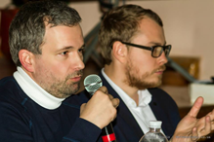
Implementation e-dem: case Boyarka

Slide 19
E-Demcracy in UA status of development after Maidan
level of trust to:
Gov. - 10% national, 20-30% local*
50+% to NGOs and volonteers*
10-20% of UAs are interested in civic activizm, BUT only 30-40% have choosed their NGOs**
50-70% of cities are interestted in:
unified e-Dem platfom
new - е-consultations
Sources of data (2017-18):
*International Republican Institute, USAID
**PACT, USAID
***Center for Innovations Development, EGAP/EEF

Slide 20
What is the future model of the community / city?
GOVERNMENT
МІСТО - ???
CITY - ???
CITY
V-1.1:BUREAUCRATIC
V-1.2: MAFIA
???

Slide 21
What is the future model of the community / city?
GOVERNMENT
МІСТО - ???
SELF-GOVERNED
CITY-COWORKING
CITY
V-1.1:BUREAUCRATIC
V-1.2: MAFIA
CIVIC

Slide 22
Next steps?
Mail: info@cid.center
FB/Skype: Loboyko
www.CID.center

Slide 23
E-Demcracy status of development
after Maidan, 2017-18:
Ukraine ranks among 193 member states of the UN
E-Democracy: 32 місце (+45)
Open DATA, е-Appeals, е-Petitions - instead of street protests?
participation (2017-18): 80% communities,
1+ million citizens (Kyiv = 50%)
Participatory budgets = self-government revolution?
participation (2017-18): 20% communities,
1+ million citizens (Kyiv = 30%)
Рlanned at the National level (!)

Slide 24
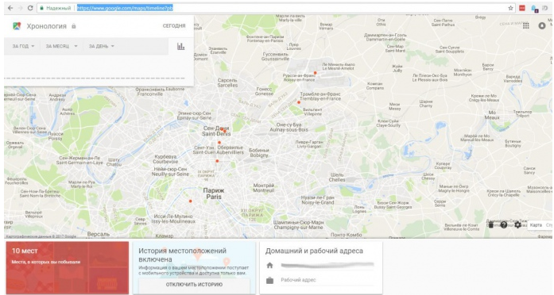
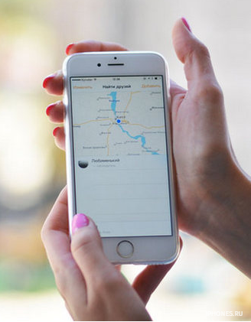
Personal data - Case: smartphone
Google is following Android users
From 2017, the company collects location data for Android devices, even if gadgets:
geolocation detection services were turned off
restore factory settings
iOS, not Android, but the owner is using the Google search

Slide 25
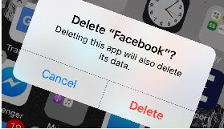
Personal data - Case: social network
Mark Zuckerberg admitted:
Cambridge Analytica (UK), who worked on the US presidential campaign, Donald Trump, revealed vulnerabilities in protecting the social network and used the personal data of 50+ million users.
User personal data was used by political technologists to influence public opinion. In particular, the results of the US elections

Slide 26
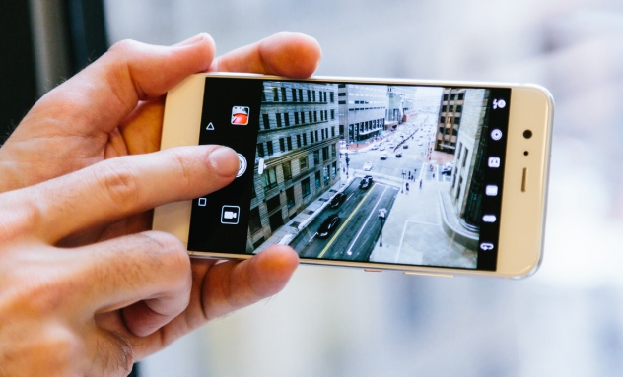
Blockchain will also appear on smartphones
Blockchain is a database for recording and saving transaction data. One of its main features is that it is simultaneously stored on many computers connected to each other on the Internet. All changes to the database of one computer are immediately copied to each computer that participates in the network
Huawei is developing a smartphone for the blockade

Slide 27
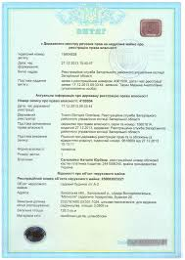
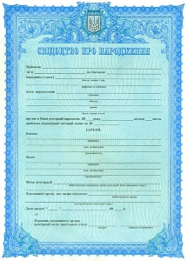
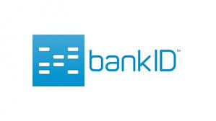
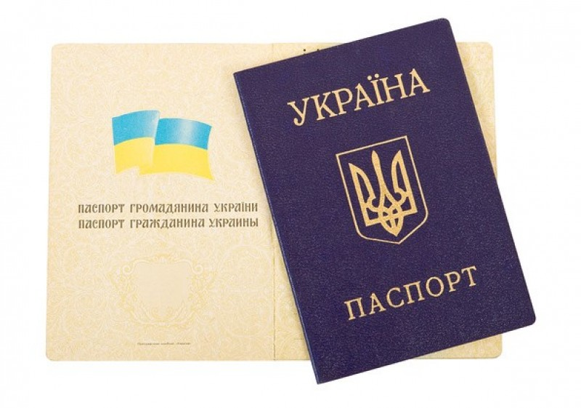
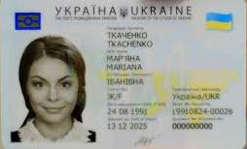
Methods of identification and voting
Electronic
9 local gov.s:
+ center for administrative services, +scans
1+2 local gov.s:
Kyiv + Lutsk, Pereyaslav-Khmelnitsky
Mixed
70
local gov.s
Paper
12
local gov.s
High risk of falsification and loss of trust

Slide 28
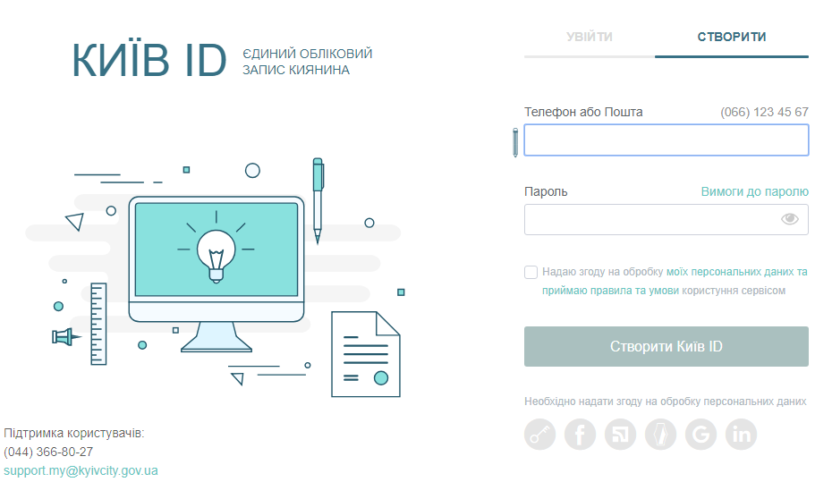
ID by e-cabinet: Kyiv: Participatory Budget
www.PB.kyivcity.gov.ua

Slide 29
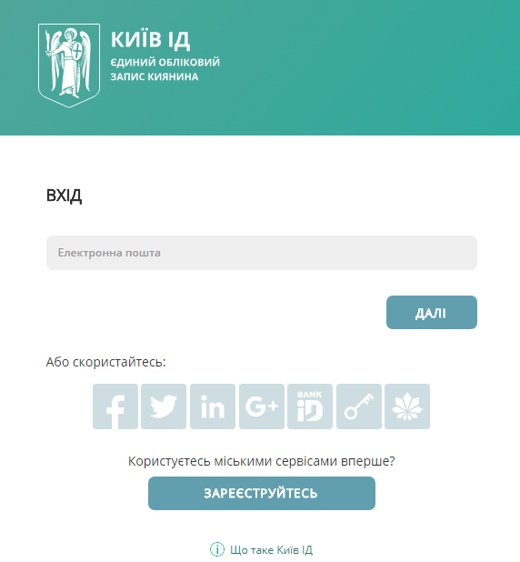
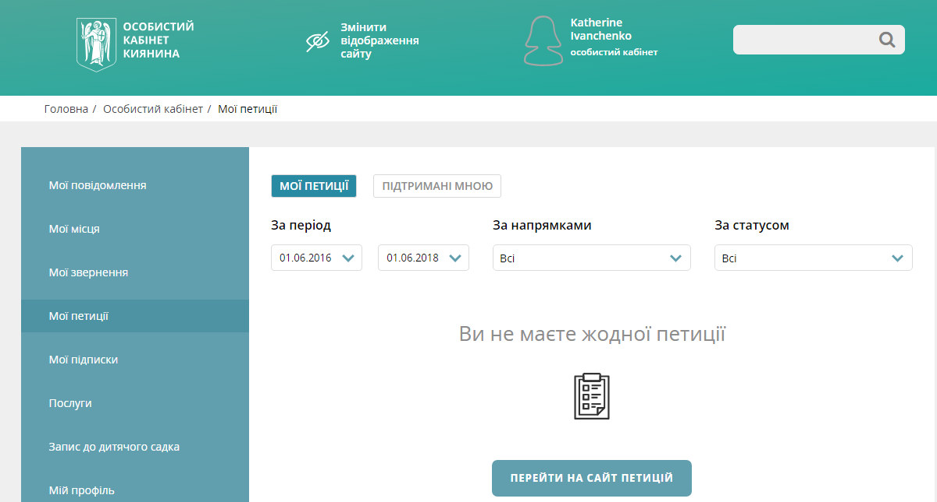
ID by e-cabinet: Kyiv: Petitions
www.petitions.kyivcity.gov.ua

