Slide 2
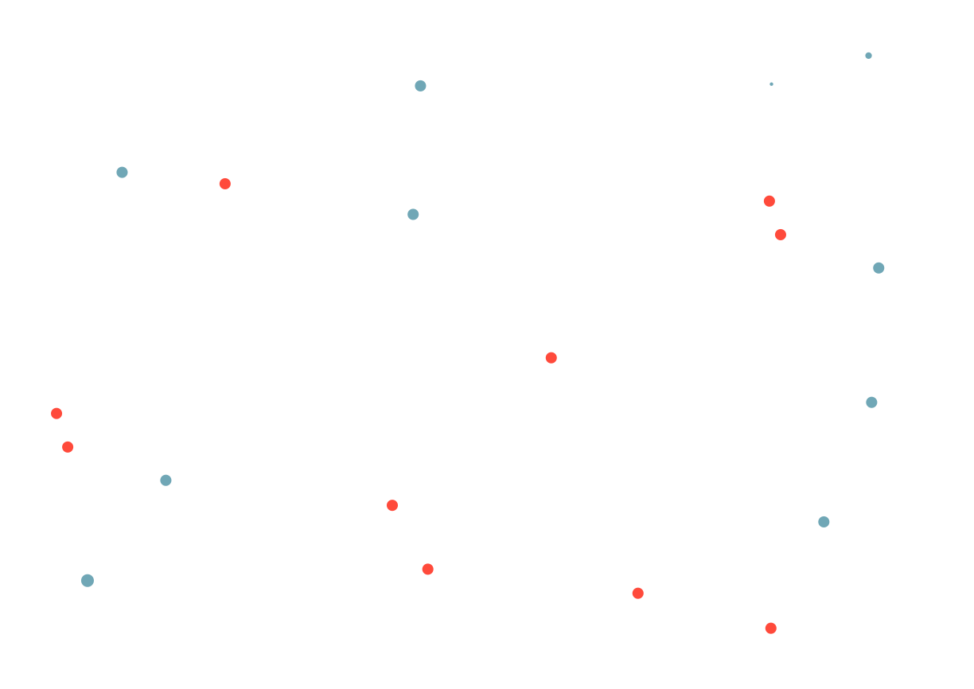
Making a portrait of your user

Slide 3
Ask participants to tell something about themselves
-key professional skill/ comptenece
-key life skill
-how can you use a brick?
And say a few words about muself
How to get from PR into ‘everything’

Slide 4
Why civic tech and state IT projects often ‘lose’ their clients
VS

Slide 5
The idea of this webinar is to discuss how we can learn the user of our product the best

Slide 6
Tell me what you know about your user?
* You can tell me things from your applications

Slide 7
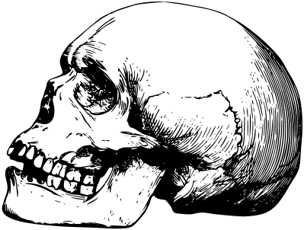
*Case from Silantyeva
Discuss the case of yoghurt with skeletons – context advert for 13-years-old.
Task for the audience: guess the key search words for the advertisment :)))
If you know the right answer, let others guess first.

Slide 8
*Case from Tsuker
A pizzeria revenues fall down. The owners say they tried everything to save the business.
Task for the audience: What did they try? :)))
If you know the right answer, let others guess first.

Slide 9
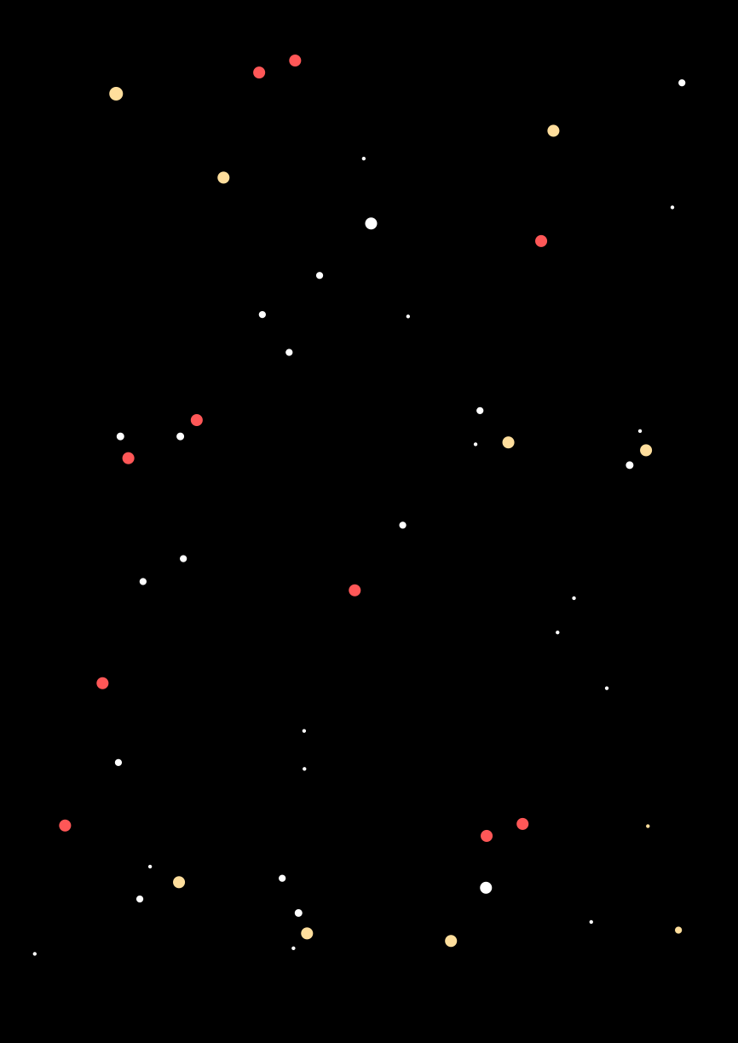
Netflix CEO explained a couple of years ago who is their main competitor...
Task for the audience: Who is that competitor ? :)))
If you know the right answer, let others guess first.

Slide 10
Green- blue- red bank - and Alfa-Bank co-working

Slide 11
When it comes to profit-oriented economy, a competitor is not obvious.
Social demographic data is not enough any more. Now we need to know other things.
Knowing your client creates profits at all stages of working with a product: development, promotion and client retaining

Slide 12
Client’s pain
(Yeap, again about the pain)
If there is a pain, there is a barrier that prevents some action or development
If there is a break in an activty, then some action does not reach its target
Now you need to know the client’s problem (his pain), what (s)he wants and fears – and not only concerning your product! Remember the pizza and skeleton cases – and many others
What does (s)he want?
What is (s)he afraid of?

Slide 13
Attention - homework!
Boring, but extremely useful

Slide 14
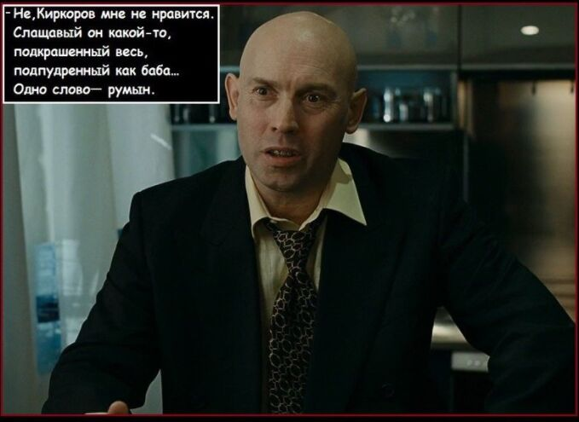
Searching for the archetype and quote
CV: age, country, social status, children, family status. Life stage (s)he is now at: (getting a child, retiring, etc.; use the life cycle document for help). People and factors that indirectly affect him/her.
Personality / archetype: simplified image of our user. For instance: «geek», «old gal», an old doddler, «economic person», «lack-in-office», etc. Ideally you need to look at the person from the angle important for your product.
Quotes that fit and describe this person, like «Money in the morning – chairs in the evening», «Our generation had fewer idiots», «No, I do not like Kirkorov, he is all sugary, painted and powdered like a dame… Romanian, what else can you expect!..», «Criminals must be in prison» and so on.
Image/picture: is an important element of your character as it really brings to life the personaluty and lifestyle. Take a photo of an actor, make a photo of your colleague doesn’t matter ☺

Slide 15
Life goals and fears of you target group. Important! We need to het what a person wants in his/her life, not as a vehicle for our product. For example, emigrate in the next 5 years, build a house and move in, get a PhD, fear to loose the pension, fear of occupation, etc.
Goals and fears related to our product. For example, fear that a teenager in an inclusive school class will get less attention; fear the police can get heavy-handed on you if they find a human right game while stopping you; fear the app is a virus?

Slide 16
Authorites: where the user gets the information from (specific newspapers, TV shows, websites, blogs) and personalities whose opinion (s)he considres (head of the state, a rock star, vlogger), how (s)he has fun.
User motivation and vanity motives. Besides the obvious motive ‘monomize his/her pain with our product’, the user also has other motives: communicate with others, show off, stay in,.. It is important to understand these motives, but also evaluate their importance correctly. You should also know what is the user’s best remuneration, and this will help us understand additional mechanisms for retaining the user. Examples of such remunerations are statuses, achievements, freebies...

Slide 17
Number of users: need to know in order not to create too expensive product for too small group (exeption: if a small group pays us enough money).
Who pays? What is the user ready to pay for the product with: money, time, attention? How much? Who else can pay for THIS user to have this product?
How much a user is ready to pay. Find this out and compare with our costs: if the costs are lower, then let’s do it!

Slide 18
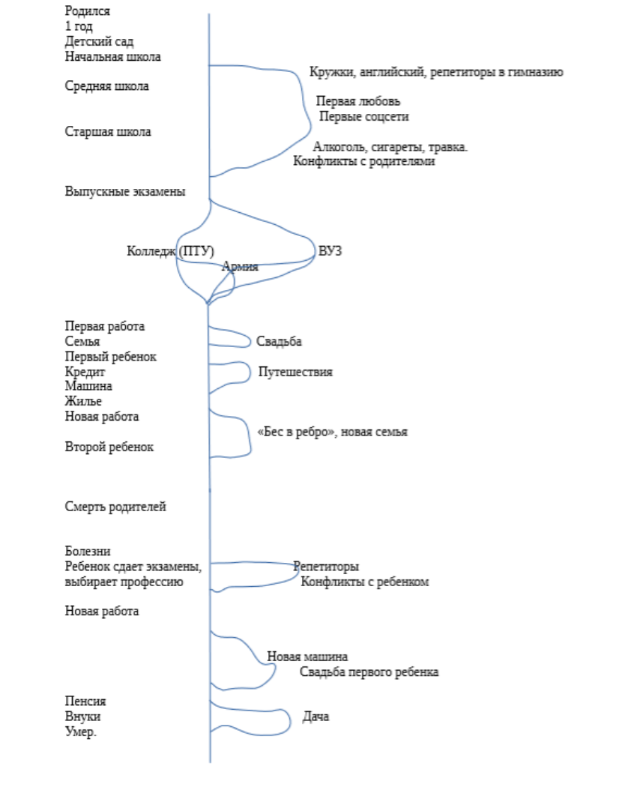
Dow you remember the skeleton case?
This process goes in parallel
Practice: at what life stage does a person buy windows?

Slide 19
Problem: we often regard users as a vehicle / function for a product.
Example: Why would people visit your website? – because it will be online.
Core value

Slide 20
Not this time, but later, check what customer journey map is

Slide 21
How do I do it in practice?
Watch(life situations, social media, forums) and talk. Come up with a hypothesis and check it.

Slide 22
What are the typical problems?
1) Cannot get separated from the project, too much in love with it. Then we ask wrong questions to qrong people and make wrong conclusions.
2) Everybody lies. All users lie. Tell a new case about lawyers.
3)Even non-concerned people have their perception distorted.

Slide 23
Toolbox
1)Interviews and focus groups with real customers.
Choice of tools depend on the customer: blind brainstorming works well if a subordinate is afraid of the boss.
2) Building hypothesis with your team and validating / verifying them.

Slide 24
How to interview?
1) Practice listening.
2) Set objectives in advance – what we want to learn.
3)Prepare questions in advance – in order to achieve the set objectives

Slide 25
Practice listening and understanding skills – what’s the main idea in this dialogue?
https://youtu.be/blZzOAUZbsg

Slide 26
Questions?

