Slide 1
Working with tech partners
Digital Competences for CSOs - blended online course, June 2019

Slide 2
Hello again!

Slide 3
Two webinars
Finding the right tech partner
Lost in translation
Define well
Do the homework
Write an amazing RFP (Request For Proposals)
Working with tech partners
The Product Manager within you
Ways of working
Tools of the Trade
Reading List

Slide 4
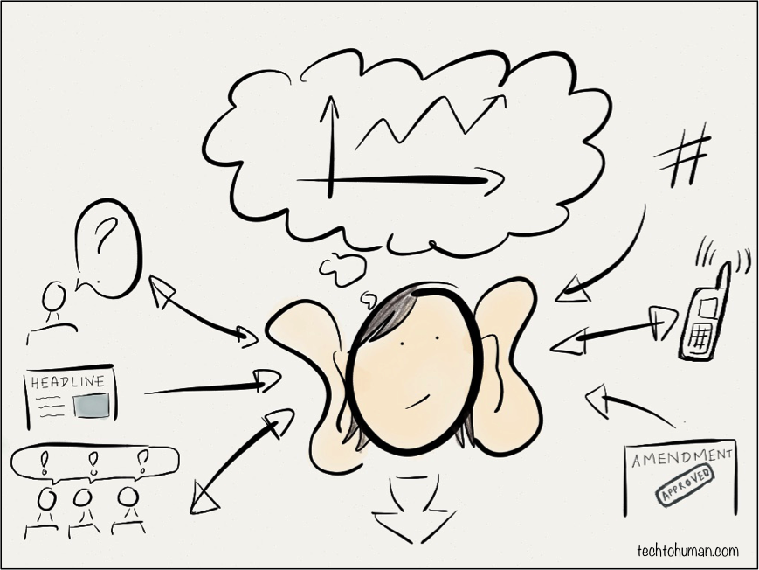
Credit: Lucy Chambers

Slide 5
You know 80% of this already

Slide 6
It is much simpler than it might seem

Slide 7
The Product Manager within you

Slide 8
Someone needs to own it

Slide 9
What does a Product Manager do
The translation layer between a team of developers and stakeholders (internal, external)
Absorbing huge volumes of information and distilling clear problem definitions
Establishing which subset of the problems technology could solve
Defining acceptance criteria so that we know when the problem has genuinely been fixed
https://techtohuman.com/5_in_5_product_management

Slide 10
Product Manager ≠ Project Manager

Slide 11
Product Manager
Figures out What and Why
Project manager
Keeps track of How and When

Slide 12
Product Manager or Product Owner?

Slide 14
Owner vs Manager
In a nutshell, the Owner protects
the vision and the aspiration
Owner is sort of the “internal client”
while the Manager wants to get things done
Translates vision and aspiration into practical, doable goals
Makes hard choices and advocates for them
Internal vs external focus
At times, Manager can take the developers’ side against Owner
They can be (and often are) the same person
...but it helps if they’re separate
https://blog.aha.io/the-product-manager-vs-product-owner/

Slide 15
2. Ways of working

Slide 16
Lean

Slide 17
Agile

Slide 18
Waterfall

Slide 19
Umbrella styles
Agile
Lean
Waterfall
Approach

Slide 20
Emphasis:
Upfront plan
Agile
Lean
Waterfall
Emphasis:
Iteration & learning

Slide 21
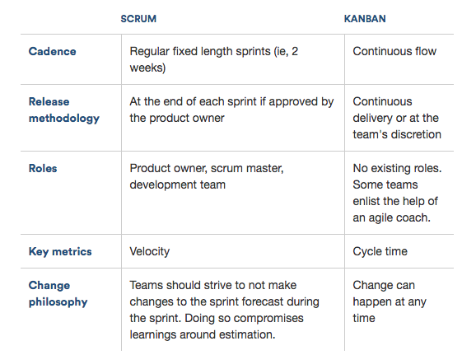
Subdivisions of “agile”
https://www.atlassian.com/agile/kanban

Slide 22
I love agile.

Slide 23
...but sometimes waterfall makes more sense.

Slide 24
3. Tools of the trade

Slide 25
Defining Personas
...because we need to know who wants it
The more specific, the more useful
But there’s no need to overdo it
Don’t forget Internal Personas!

Slide 26
Writing Stories
User oriented
As a [USER PERSONA] I want to [GOAL] so that [EXPECTED BENEFIT]
As a freelance investigative journalist, I want to know when certain information was last updated, so that I know if the info is still relevant
Job to be done
When [SITUATION] I want to [GOAL] so that [EXPECTED BENEFIT]
When a content page is updated, I want to see it clearly stated on the page, so that I know that the information has changed.
https://techtohuman.com/user_stories_jtbd

Slide 27
Writing Definition of Done
...because you and developers need to be able to measure if something is completed
Usually comes with Acceptance Criteria: measurable, testable explanations of how it’s supposed to work
Update feature Acceptance Criteria:
“Last updated”date clearly visible on page
“Last updated” date changes each time page content is updated

Slide 28
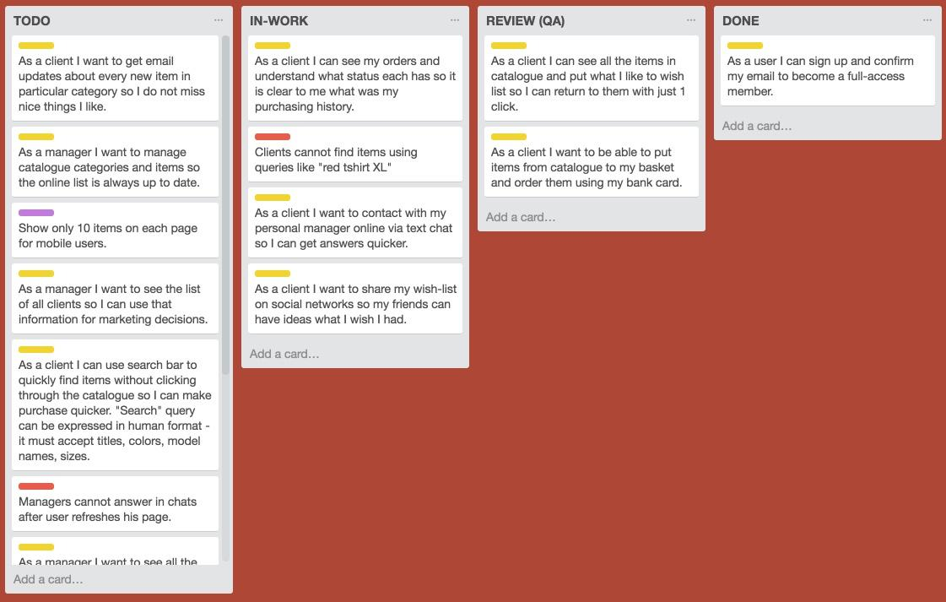
A place to put it all

Slide 29
Tools of the Trade
Defining Personas
Writing Stories
Specifying Definition Of Done
A place to put it all

Slide 30
4. Reading List

Slide 31
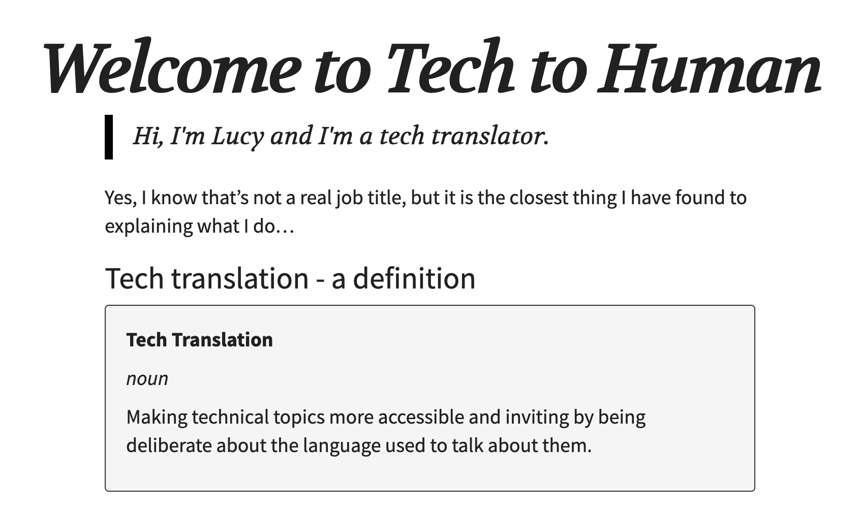
Tech To Human
https://techtohuman.com/

Slide 32
Talking to Humans - the book
https://www.talkingtohumans.com/
Good resource on user research
Free for non-profits

Slide 33
SCRUM - the book
https://www.goodreads.com/book/show/19288230-scrum

Slide 34
Civic Patterns dot org
http://civicpatterns.org/

Slide 35
Thank you!

